Slide 1
Credit Card Fraud Detection
Submitted by Nikhil M Kanchan

Slide 2
Agenda
Objective
Background
The Model
Cost-Benefit Analysis
Model Stats
Insight – Transaction Amount
Insight – Night time online shopping & Frauds
Insight – Population Factor
Insight - Demography based Frauds
Recommendation
Appendix
Data
Assumption
Other Options
Methodology

Slide 3
Objective
Build a machine learning based model that can detect Fraud Credit Card transactions and save cost incurred to bank due to these fraud transactions
Provide Cost-Benefit Analysis
Provide insights based on data

Slide 4
Background
Credit card fraud is any dishonest act or behavior to obtain information without the proper authorization of the account holder for financial gain. Major ways to committing such frauds are:-
Skimming
Manipulation or alteration of genuine cards
Creation of counterfeit cards
Stolen or lost credit cards
Fraudulent telemarketing
Our Client Bank needs to repay the customer for the entire amount flagged as fraudulent. This is a very big amount of Approx. $ 213K a month.
To define the model, two years of data from 1 Jan 2019 to 31 Dec 2020 was provided in 2 datasets. The main dataset having 1.2M records while the train dataset having 0.5M records.

Slide 5
The Model
The Machine Learning based model we are taking about is an efficient way to handle Fraudulent transactions. It helps the bank save big on the Fraud transactions. Here are the Pros and Cons of the model.
Pros
Savings of $202K (95%) per month
Detects Fraud transactions real time - saving bank money and bad customer experience
Less burden on Call Centre executives and legal teams handling the victims of Fraud.
Least deviation in metrices when executed on Train & Test.
Cons
A handful of fraud transactions ( 19 monthly) will still go undetected costing around 10K (Final savings already include this amount).
Couple of genuine transactions (< 700 monthly) may get flagged as fraud causing bad customer experience and small load on cost centre. However this count, cost and load is a fraction of what bank is dealing currently.

Slide 6
Cost-Benefit Analysis
Current Process | Average number of transactions per month | 77,183
 | Average number of fraudulent transaction per month | 402
 | Average amount per fraud transaction | $ 530.66
 | Cost incurred per month before the model was deployed | $ 213,325.32
ML Based Model | Average number of transactions per month detected as fraudulent by the model | 686
 | Cost of providing customer executive support per fraudulent transaction detected by the model | $ 1.5
 | Total cost of providing customer support per month for fraudulent transactions detected by the model | $1,029.00
 | Average number of transactions per month that are fraudulent but not detected by the model | 19
 | Cost incurred due to fraudulent transactions left undetected by the model | $ 10,082.54
 | Cost incurred per month after the model is built and deployed | $ 11,111.54
 | Final savings = Cost incurred before - Cost incurred after | $ 202,213.78
 | Percent Saving | 95%

Slide 7
Model Stats
Actual | Predicted | Predicted
 |  | Not Fraud | Fraud
 | Not Fraud | 1,835,455 | 7,288
 | Fraud | 466 | 9,185
Important Features
Amount of transaction
Transaction Time
Transaction Category
Overall Accuracy : 99.6%
Overall Precision : 57.5%
Overall Recall : 93.6%
TRIAN – Area under ROC : 1.00

Slide 8
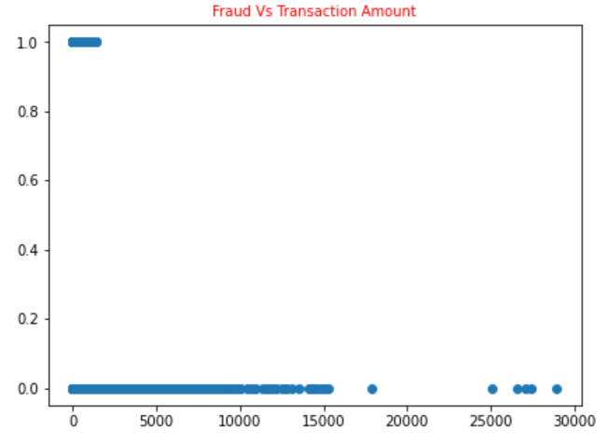
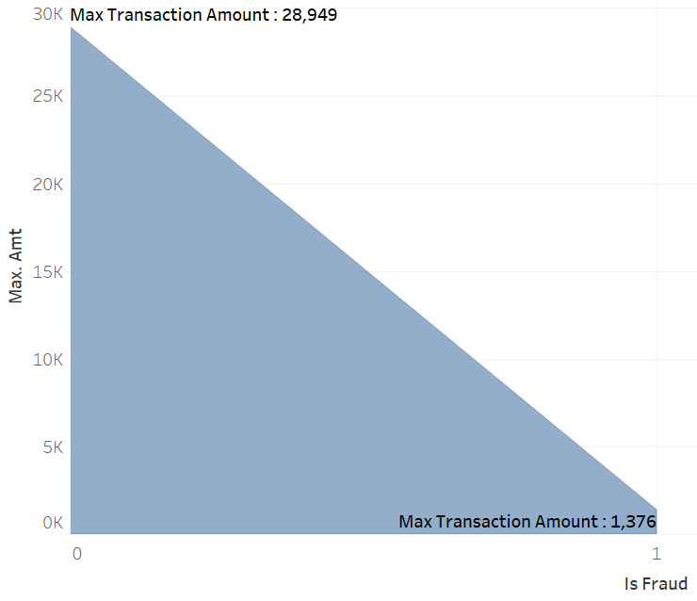
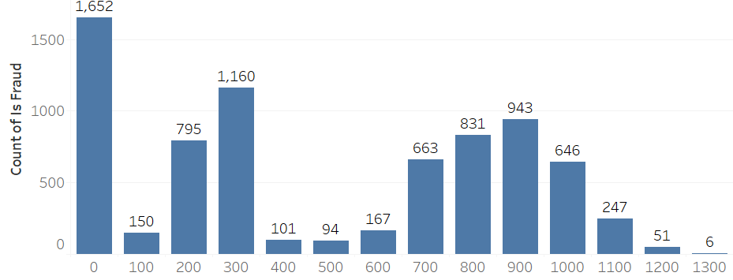
Insight – Transaction Amount
Frauds have always happened in lower amounts Range with max transaction amount of a fraud transaction being $1,376.04 and average of $530.66.
$531.30 is average amount for just the train dataset.

Slide 9
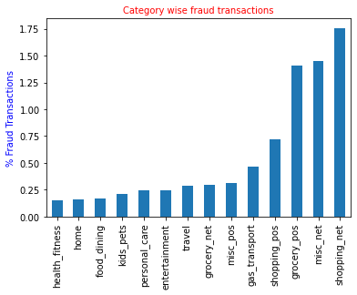
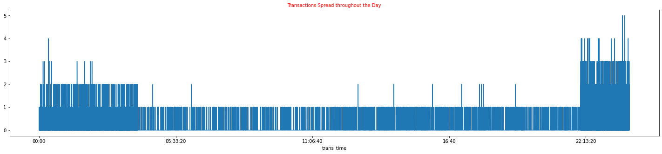
Insight – Transaction Time & Category
Online Shopping (shopping_net) is most prone to Fraud. There are many frauds during Grocery shopping also.
Late nights and early mornings are the most prone time for frauds. Highest frequency of frauds is between 10 pm to 12 am. 12 am to 4:00 am also shows very high frequency of fraud transactions.

Slide 10
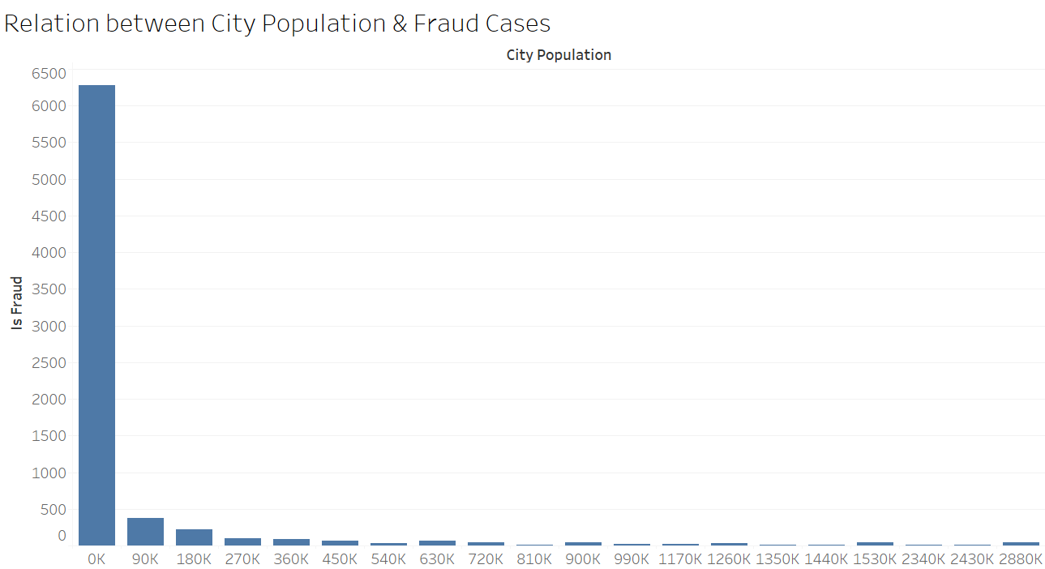
Insight – Population Factor
Population Factor
Cities with lower population experienced more fraud cased than the cities with higher population. Worst effected are the cities with population < 90k

Slide 11
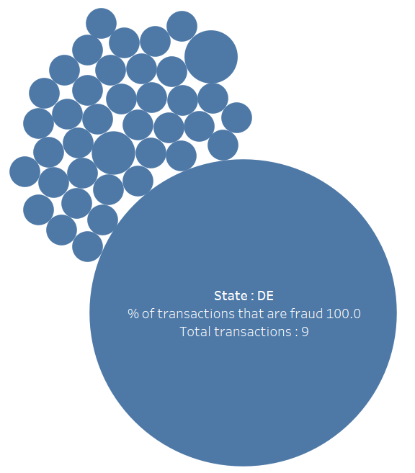
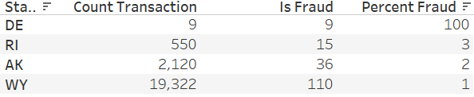
Insight - Demography based Frauds
100% Frauds
While very less transactions have happened in Delaware (DE), all of them are fraud.
58 cities (ex Las Vegas) also had very less transactions but all Frauds.
There are 73 Zip codes that contribute to less number of transactions but all Frauds.
There are 19 different job categories (ex Air Traffic Controller) that product very less but transactions but all frauds.

Slide 12
Recommendation
We highly recommend to proceed with the selected model to:-
High Reduction in Cost ($202K per month).
Minimizes bad customer experience due to fraudulent activities.
Best balancing between detecting actual frauds and incorrect flagging as fraud.
The model can be further enhanced post implementation based on daily feed.

Slide 13
Appendix - Data
This is a simulated data set taken from the Kaggle website and contains both legitimate and fraudulent transactions.
The data set contains credit card transactions of around 1,000 cardholders with a pool of 800 merchants from 1 Jan 2019 to 31 Dec 2020. It contains a total of 18,52,394 transactions, out of which 9,651 are fraudulent transactions.
The Data is already divided into Train & Validate datasets with train dataset having 1,296,675 records from entire 2019 till mid 2020 and validate dataset having 555,719 records from mid 2020 till end of 2020.
The data set is highly imbalanced, with the positive class (frauds) accounting for 0.52% of the total transactions.
The imbalance in both train and validate dataset is similar.

Slide 14
Appendix - Assumption
Cost is not the only factor to select the model. Low cost models are available but they tend to detect legitimate transactions as fraud.

Slide 15
Other Options
The model described till now is the best model when it comes to balancing between cost & recall at one hand and precision (& bad customer experience) at other. Here are some other options if bank wants to check various combinations of Price & Metrices.
Model | FP | FN | TP | Precision | Recall | Accuracy | Cost | Feature
XGB - Grid Search - RO – 1 | 2,447 | 674 | 8,977 | 78.6% | 93.0% | 99.8% | $15,572.48 | Moderate cost Detects fair number of Frauds Least incorrect flagging
XGB - US - 2 | 46,987 | 126 | 9,525 | 16.9% | 98.7% | 97.5% | $6,185.80 | Lowest Cost Detects maximum frauds Incorrect flagging is also High
XGB - ADA - 2 | 8,677 | 563 | 9,088 | 51.2% | 94.2% | 99.5% | $13,315.18 | Low Cost Good number of Frauds detected Lesser Incorrect flagging

Slide 16
Appendix – Methodology
Please refer the attachment for detailed methodology followed for the Model Building.

